Slide 1

Internet Movie Database(IMDb)
By: Wizards at Work
Yogita Suryavanshi
Hrushikesh Pokala
Saroj Saran
Preeti Khatri

Slide 2

Abstract
The Internet Movie Database (IMDb) is a website that acts as a global film database.This website provides a wealth of public information about films, including the title, the year of release, the genre, the audience, critics' ratings, the length of the film, the synopsis of the film, actors, directors, and much more.Given the vast amount of information available on this site, we thought it would be interesting to examine the data on movies on the IMDb website from 2000 to 2017.
Our project focuses on such IMDb datasets, with one dataset focusing on 45,000 movies and containing 26 million ratings from 270,000 users on a scale of 1-5, and the other dataset focusing on 45,000 movies and containing 26 million ratings from 270,000 users.This dataset includes films that were released on or before July 1, 2017.This dataset has been normalized and added to the Ohio S3 bucket.We also took another dataset with 6 million records, which we put in the Oregon S3 bucket, and created a single cluster in Ohio where the tables for all the datasets were created.

Slide 3

Objective:
Our project aims to analyse the movies data for two different data sources , one with datalength of 6 million IMDB data and second data source of 45,000 movies with various graphical representations to give an interpretation of these movie datasets.

Slide 4
Project Walkthrough...

Slide 5
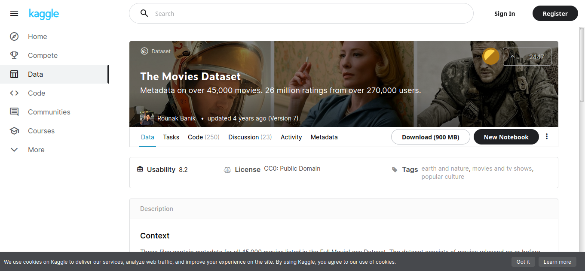
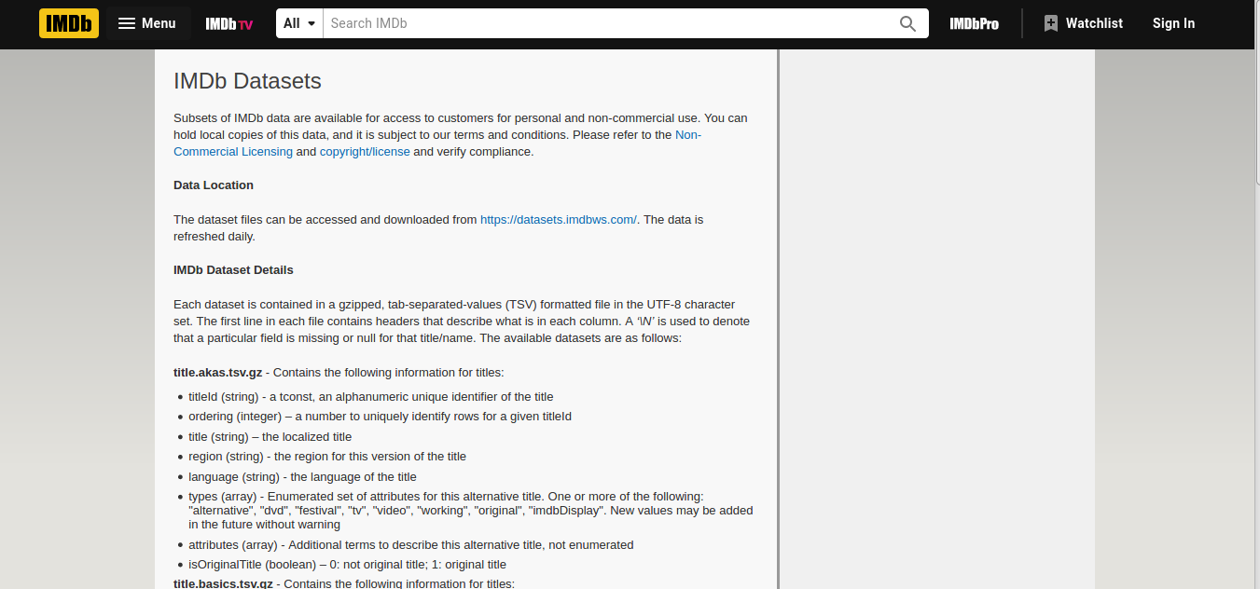
Data Sourcing
We have sourced our data from two different datasets:
Datasource 1 :This dataset is from Kaggle which involves metadata of 45000 movies. This data set is normalized.
Datasource 2 :This dataset is from IMDB which involves data length of 6 million and it is in denormalized form.

Slide 6
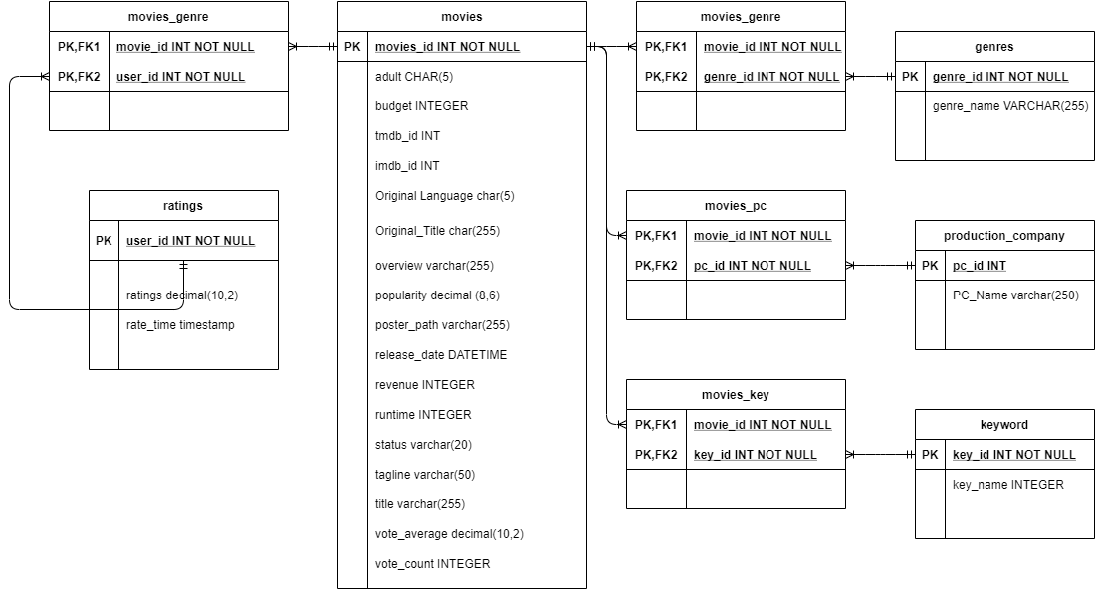
Data Modelling
ER DIAGRAM : Data Source 1
We have following major entities in our first data source:
Movies
Ratings
Plot Keywords
Movie Genre
Production Company

Slide 7
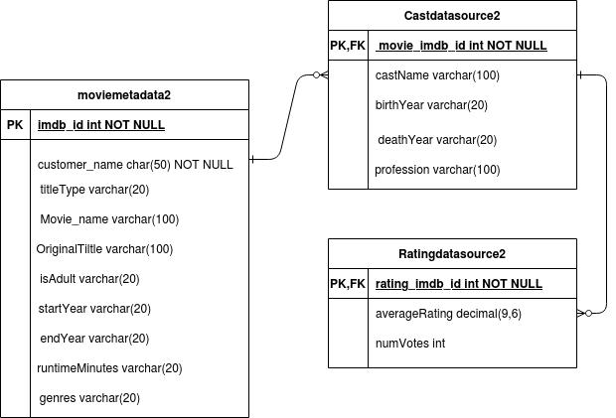
ER DIAGRAM :
Data Source 2
We have following major entities in our second data source:
Moviemetadata
Castdata
Ratingdata

Slide 8
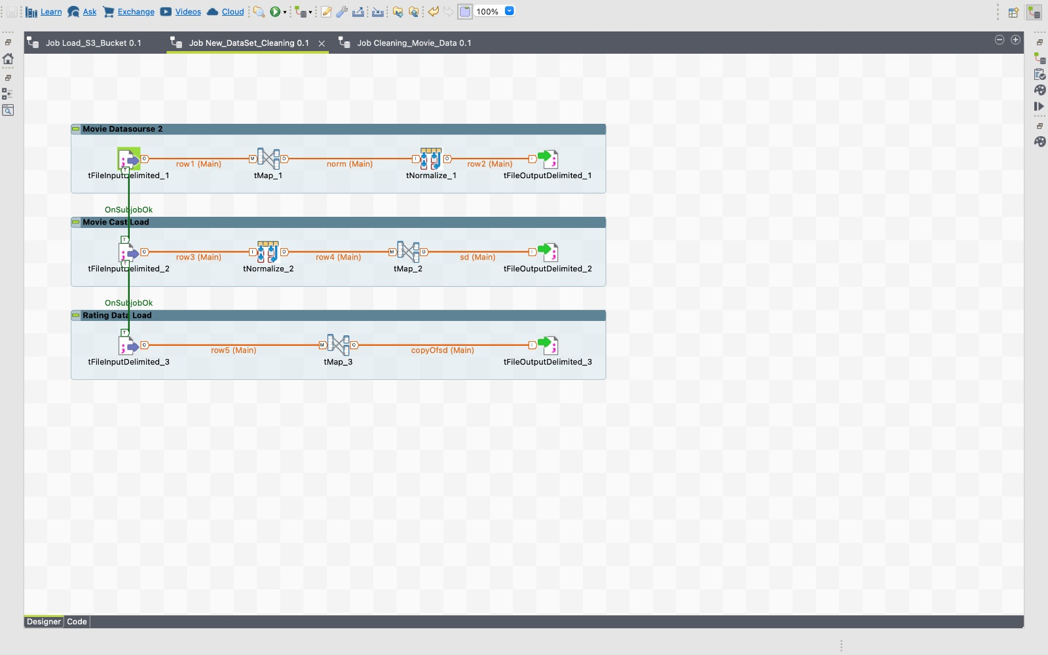
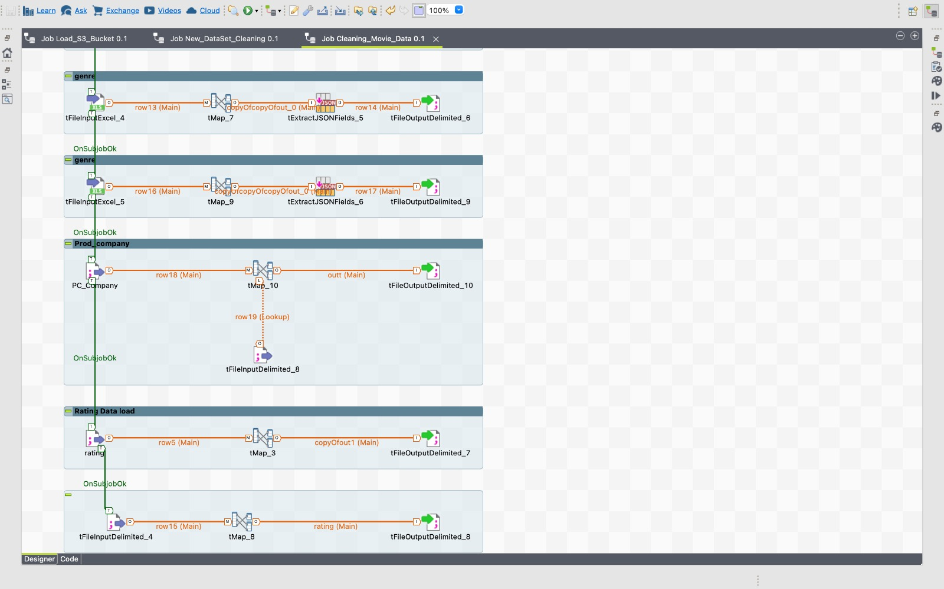
Data Cleaning
Using Talend ETL tool we have cleaned the datasets. As we have two different data sources, data source 1 was of 45000 movie records which were cleaned and transformed using ETL and then the generated CSV was loaded to S3 bucket to create tables in Clusters. Whereas data source 2 is consisting of millions of IMDb records that were cleaned, transformed, and loaded to the S3 bucket directly.

Slide 9
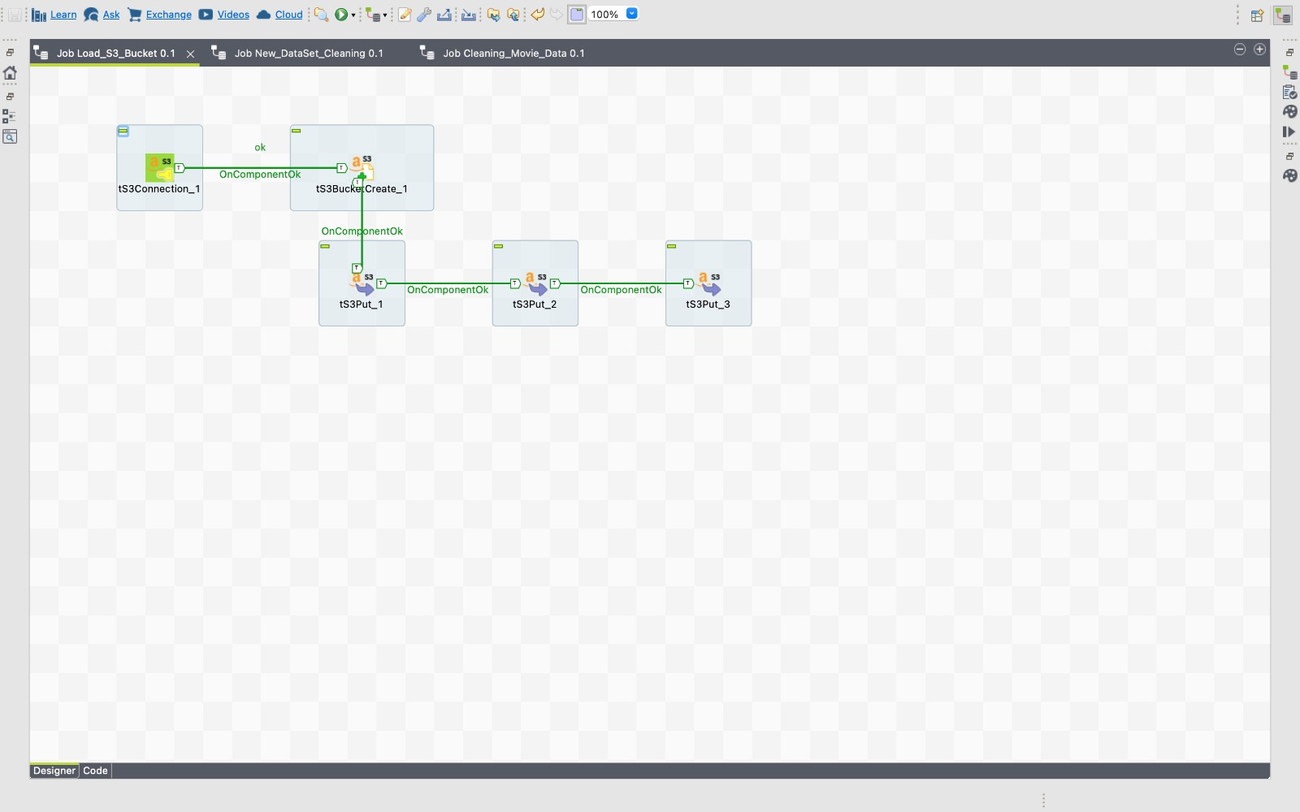
Talend has been used for data extraction, Transforming. Some of the data cleanings have also been done with Talend jobs. Job has been created in such a way that it takes all the data CSV file as input and transforms it according to requirement and loads it in the Amazon S3. Talend job has been loaded in the repository.

Slide 10
Talend has been used for data extraction, Transforming. Some of the data cleanings have also been done with Talend jobs. Job has been created in such a way that it takes all the data CSV file as input and transforms it according to requirement and loads it in the Amazon S3. Talend job has been loaded in the repository.

Slide 11
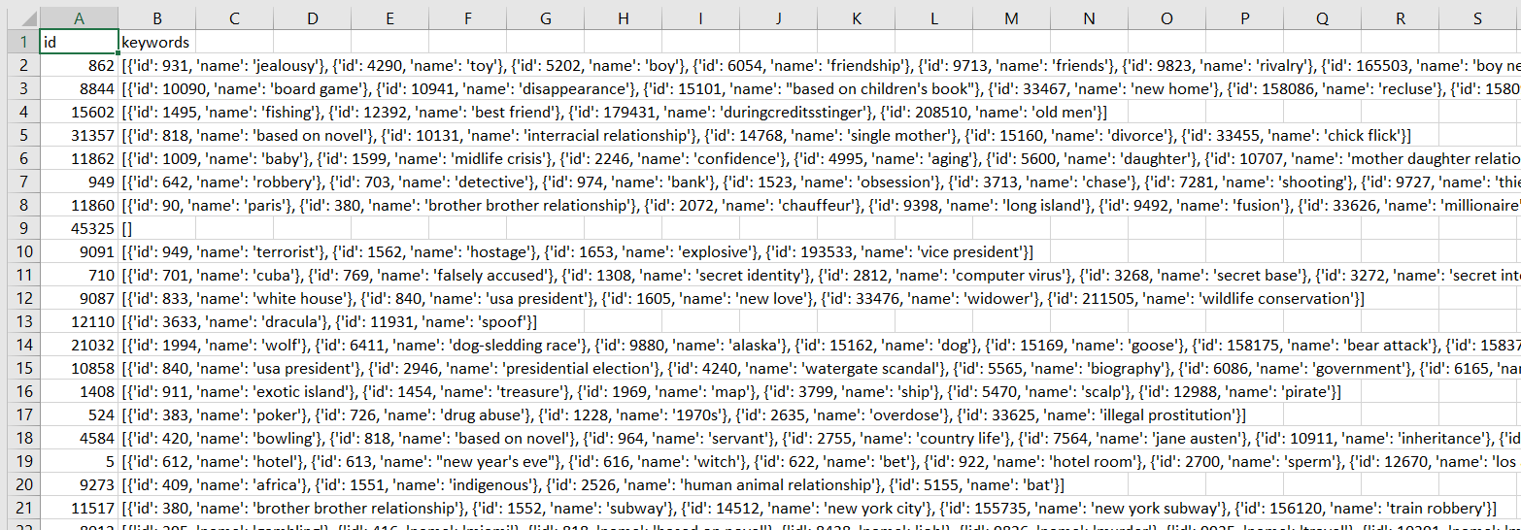
Few of the files in data source 1 had data in json format, which we had to handle as part of data cleaning

Slide 12
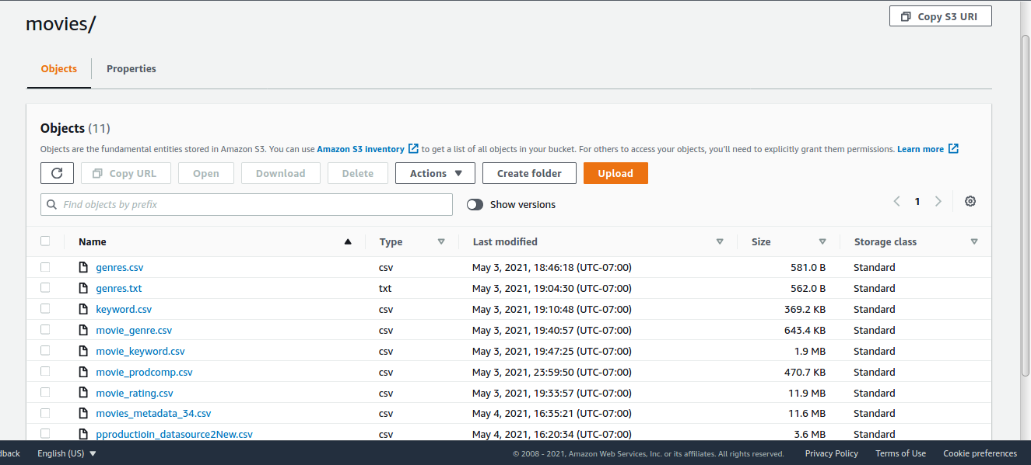
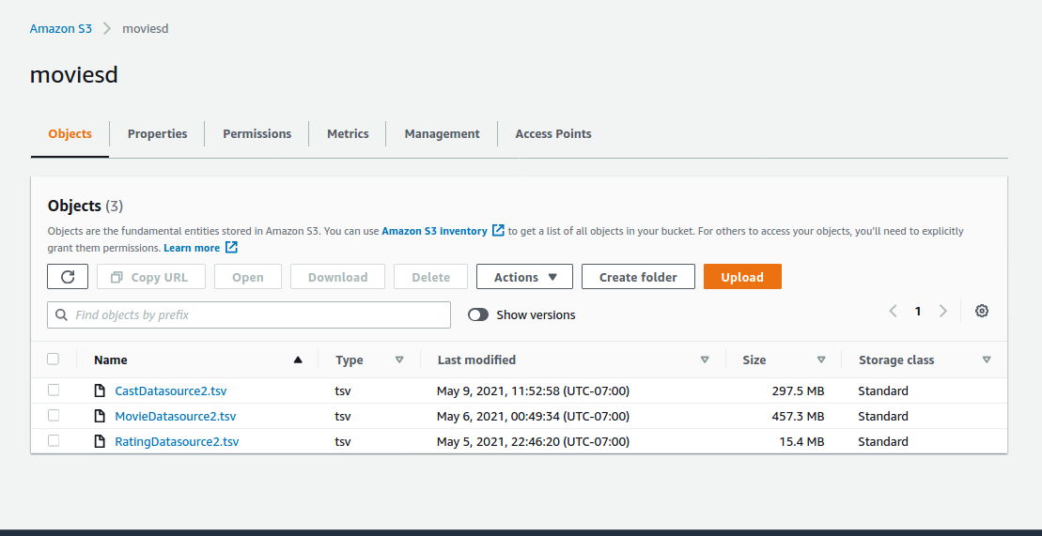
Data Loading
We have loaded the data files from different sources into two different s3 buckets in different regions (i.e Ohio and Oregon) via Talend ETL.This was done by enabling cross region replication.

Slide 13
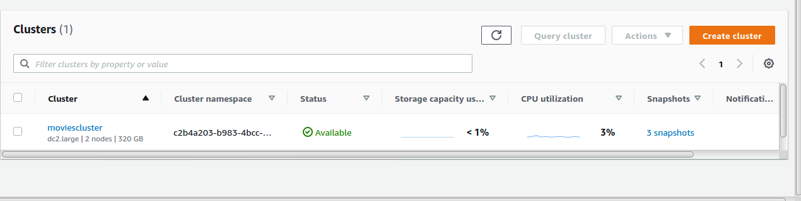
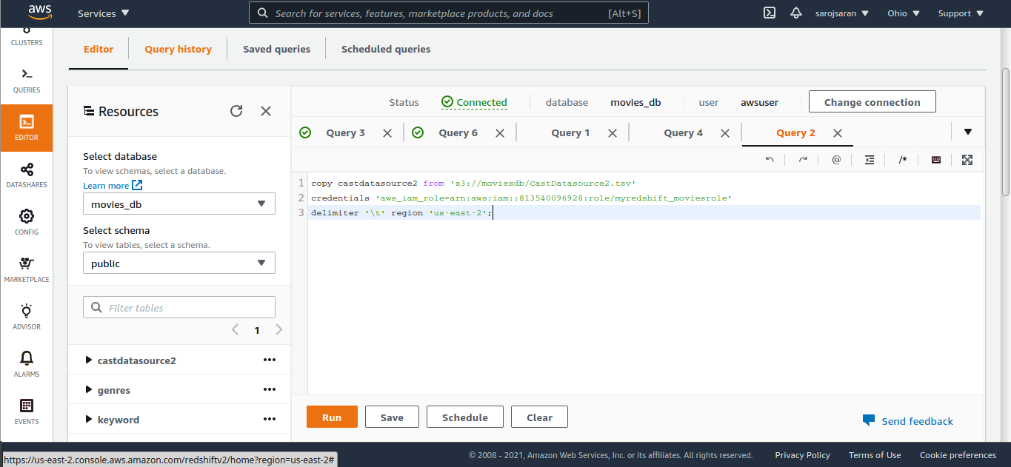
By creating a Redshift Cluster we have created the tables and have loaded files into the tables using Redshift Query Editor.

Slide 14
Data Analysis and Visualization:
Now that we have cleaned and loaded the data to clusters, Next we have is data extraction for analysis and visualization.
we have tried two platforms :
Tableau : Connecting Tableau application to Amazon Redshift.
Python : Connecting python to amazon Redshift cluster.

Slide 15
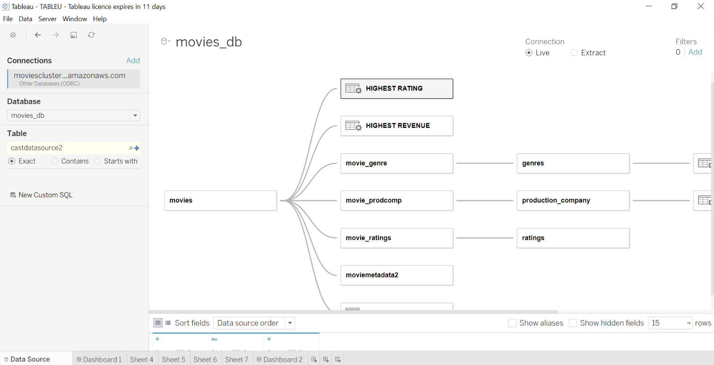
Tableau
We have connected Tableau to our Redshift Cluster and have conducted analysis on the created tables for the two data sources.

Slide 16
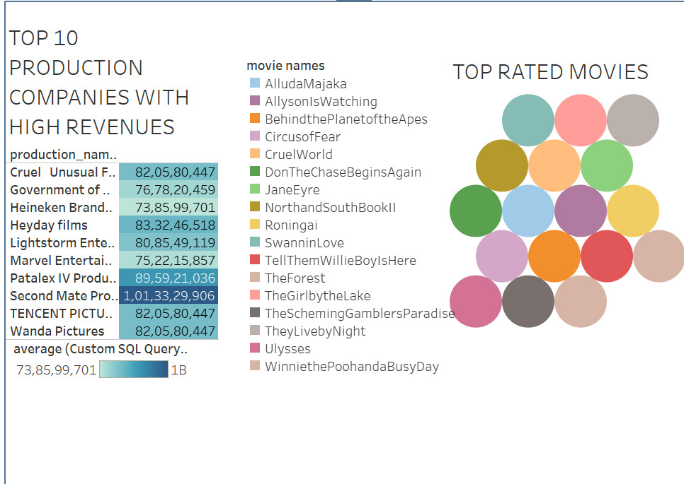

Slide 17
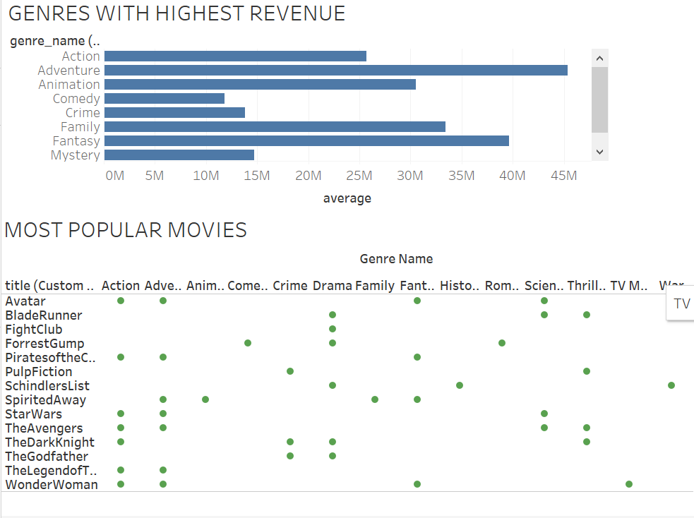

Slide 18
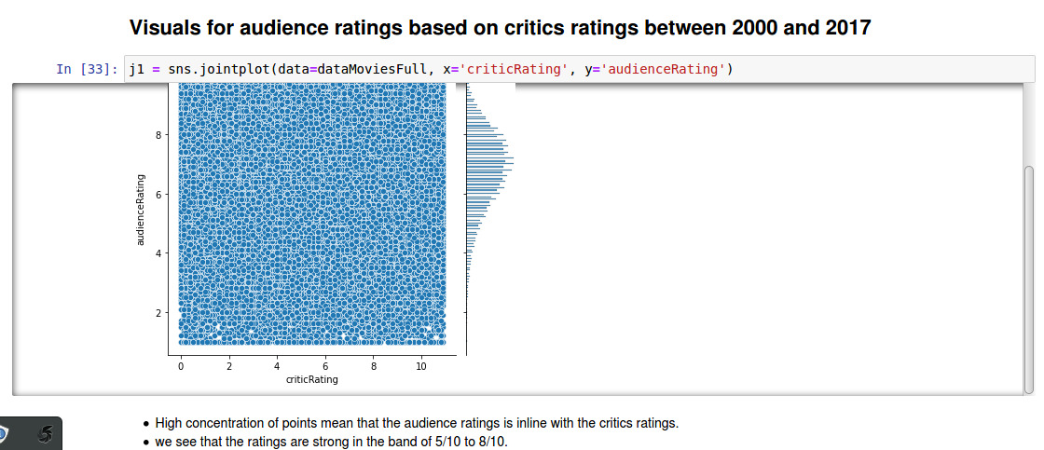
Python: In python we have used below modules and libraries.
Python stack: Numpy, Matplotlib, Pandas and Seaborn

Slide 19
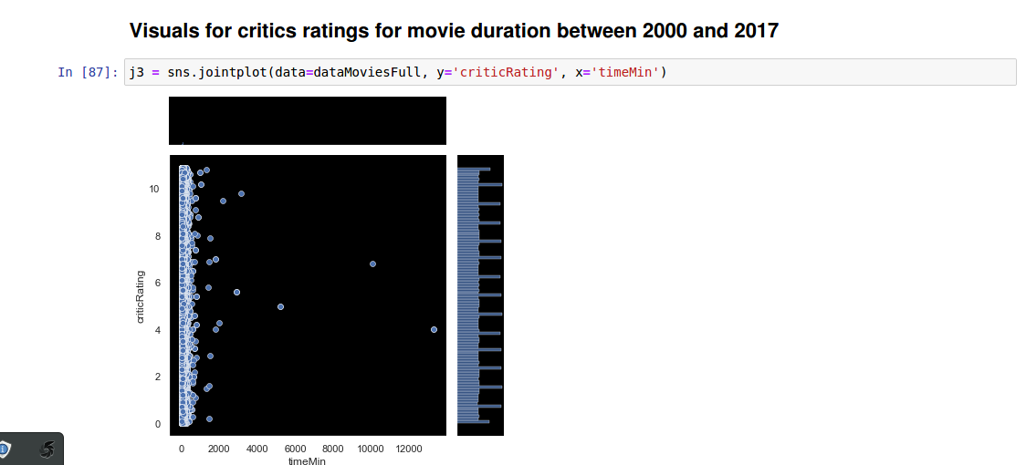

Slide 20
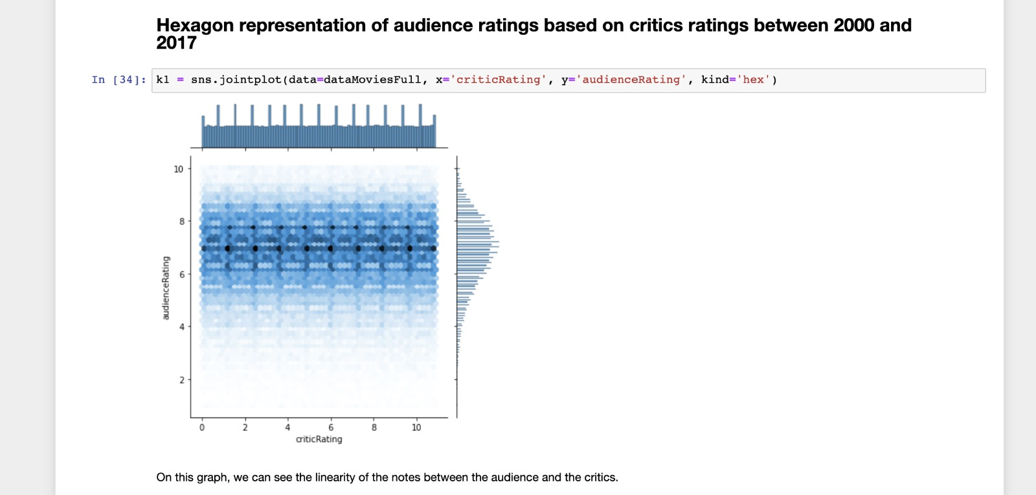

Slide 21
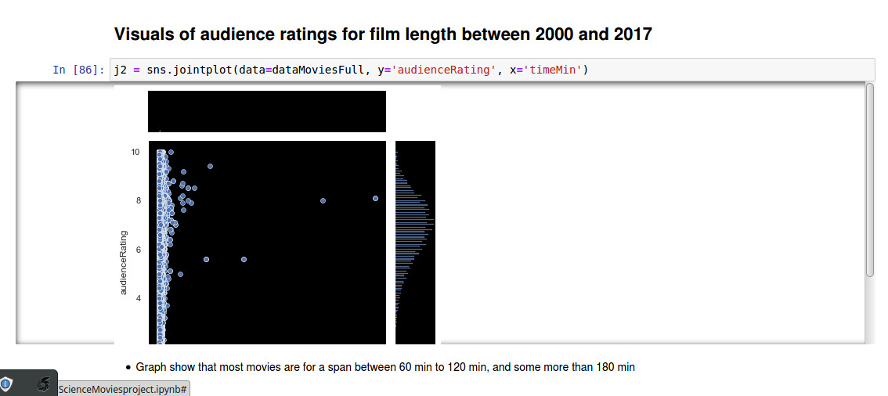

Slide 22
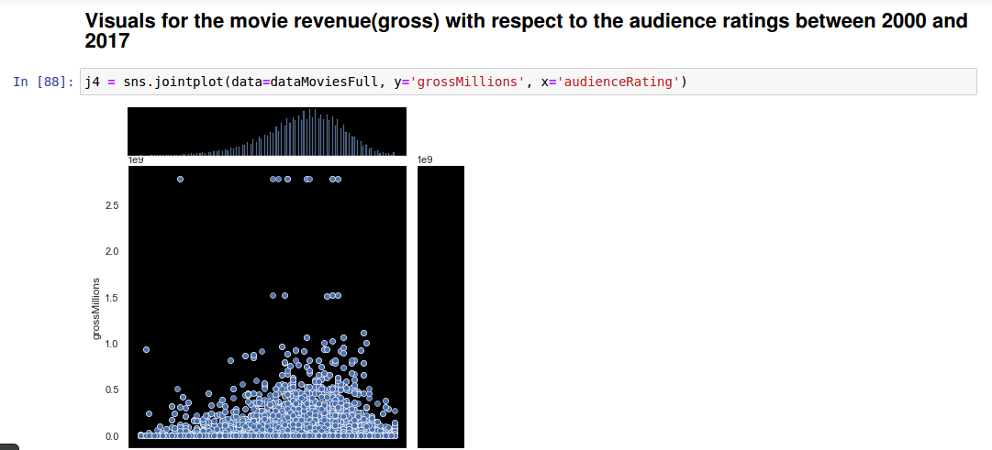

Slide 23
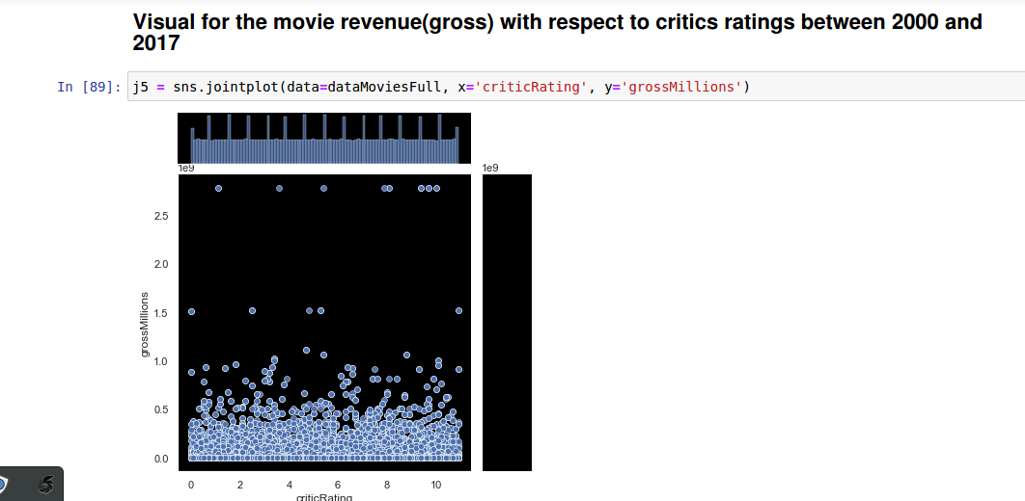

Slide 24
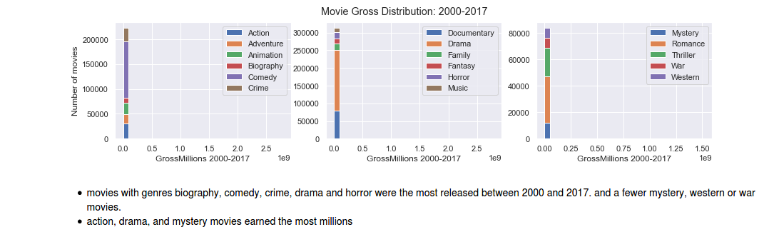

Slide 25
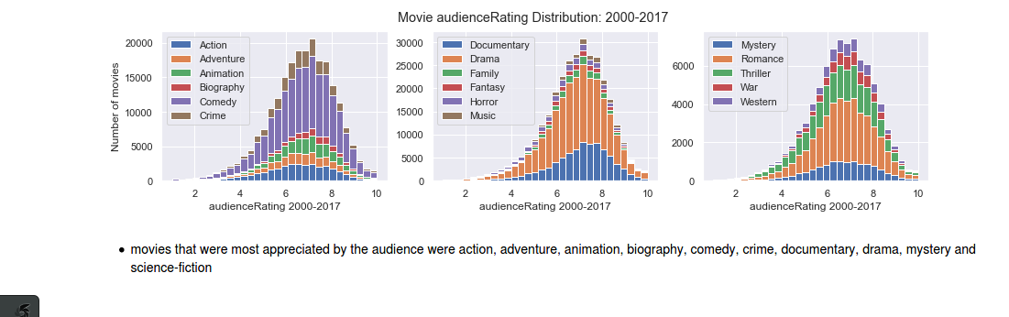

Slide 26
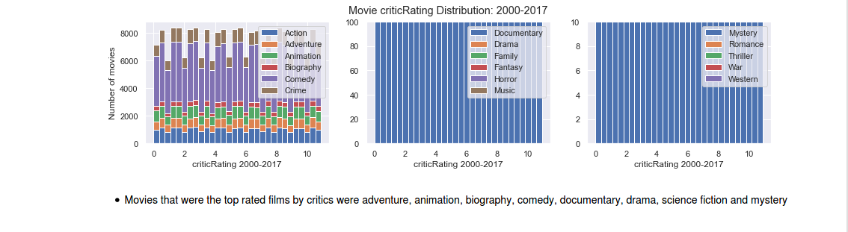

Slide 27
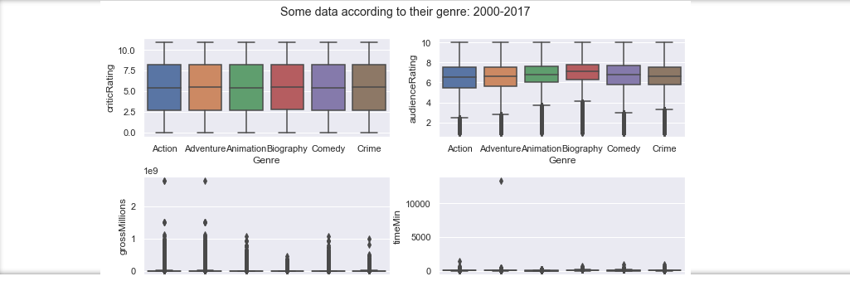
Below is the boxplot representation of critics ratings and audience ratings wrt to the genre, which shows that the critics ratings are strict and can vary with a range from 2 to 8 whereas the audience ratings are mostly in the range of 6 to 8

Slide 28
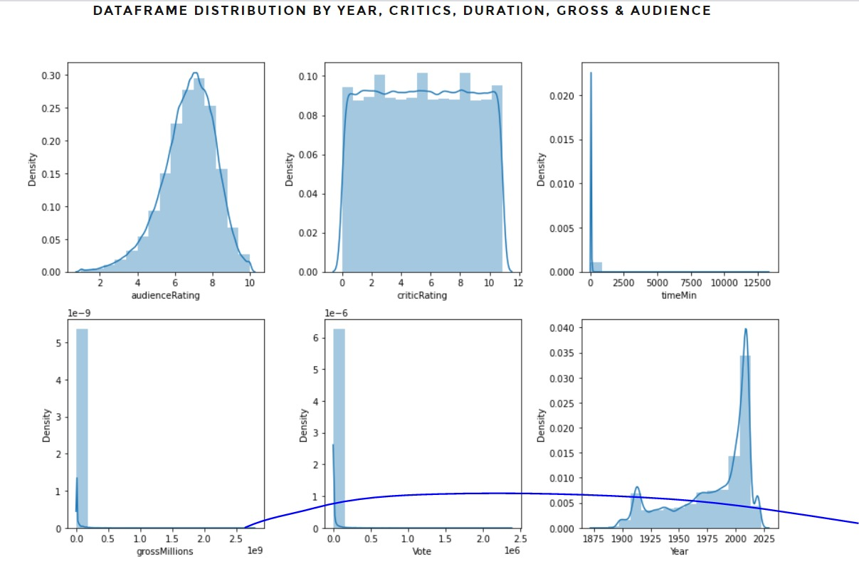
Below is the dataframe distribution, we can see the concentration of graph for audience ratings,critics ratings,movie runtime,gross millions earned by movies,vote,year

Slide 29
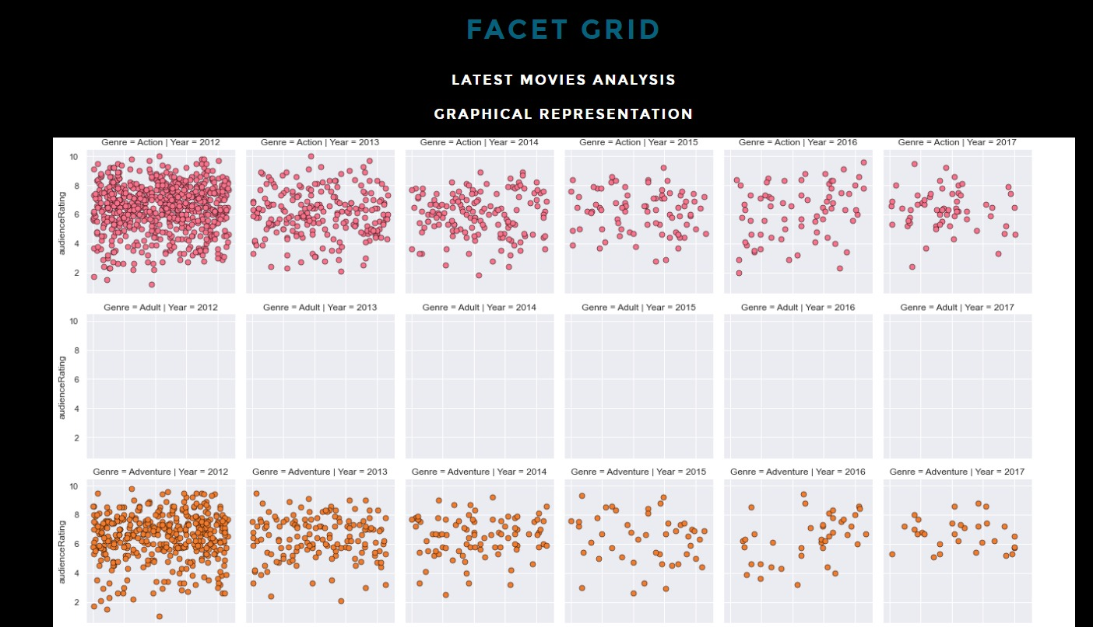
Below is the Facet grid, to show the audience ratings for each genre, and how the ratings varied over a year of 2012 to 2017

Slide 30
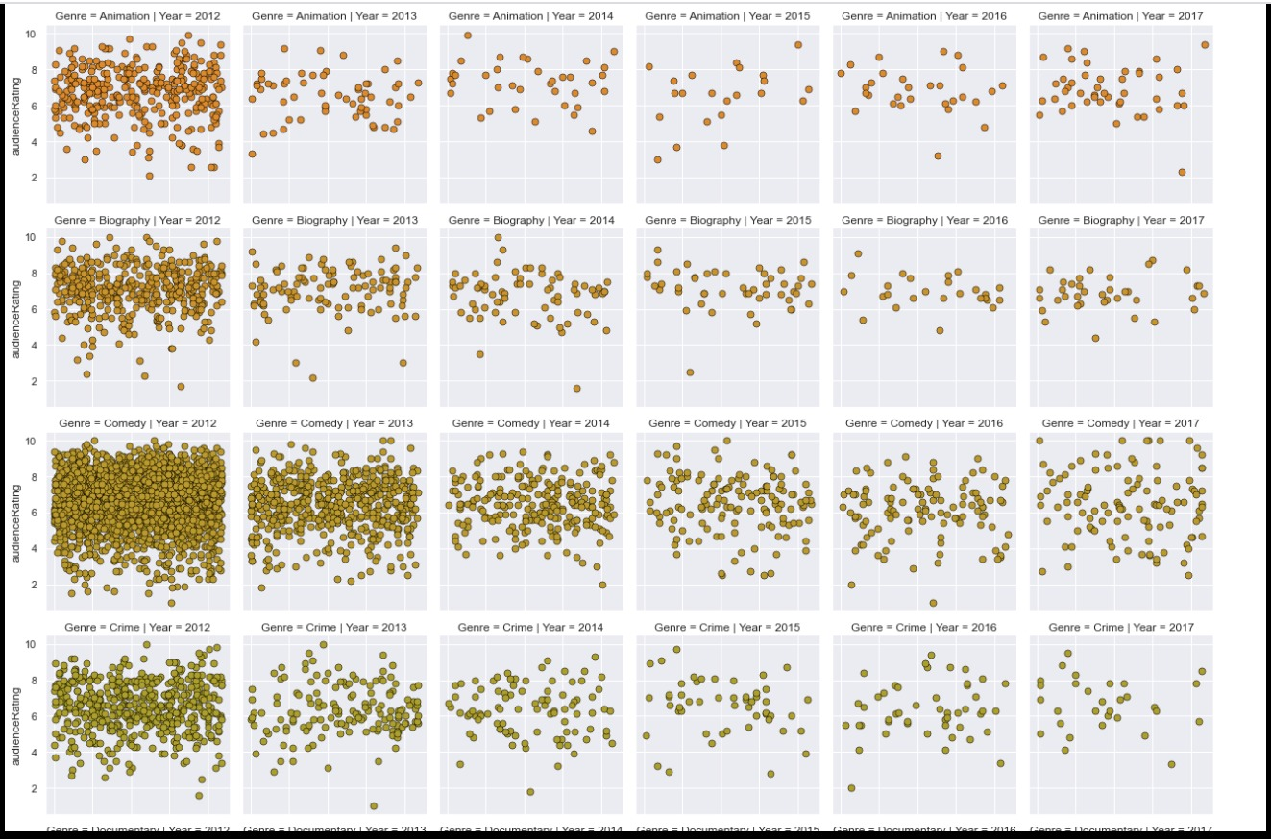

Slide 31
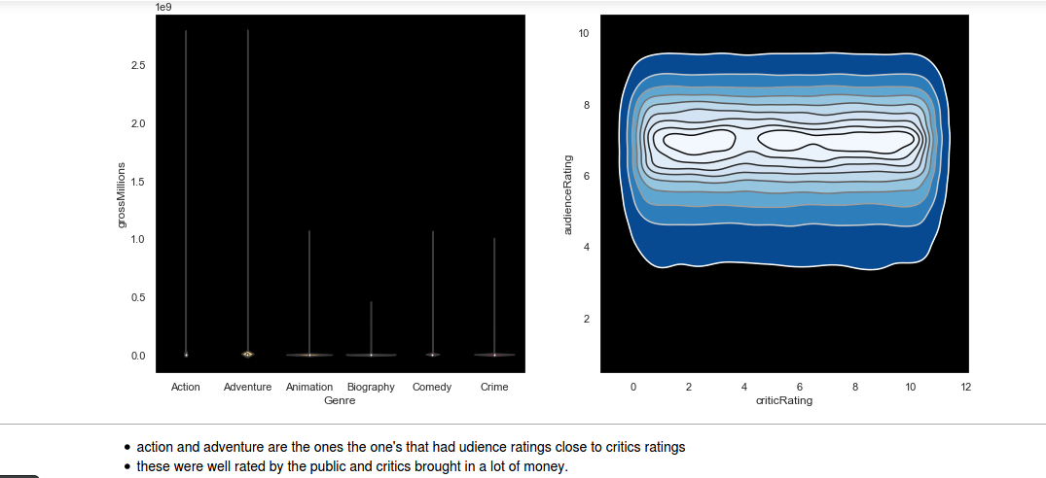
Histogram representation of the facet grid

Slide 32
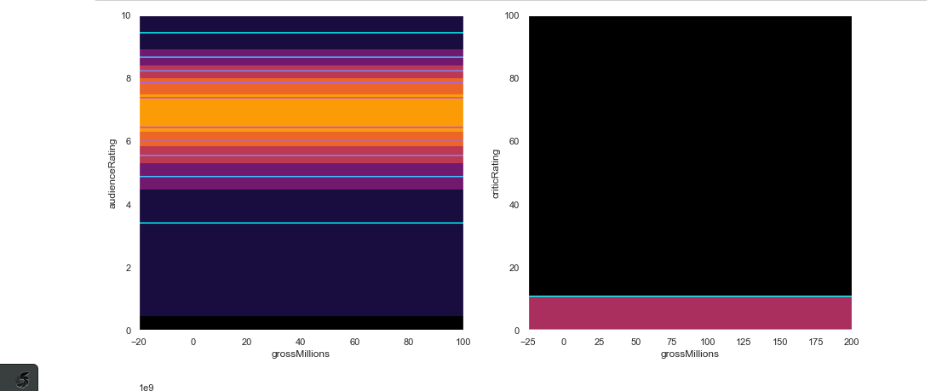

Slide 33
Findings
Tableau
Top 10 production companies that with highest revenue
Top Rated Movies
Genres with the highest revenue
Most popular movies

Slide 34
Findings
Python
Critics ratings are more severe than the public ratings.
Audience ratings of the movies were quite close to those of the critic’s ratings.
Average Movie duration is mostly ranging from 60 minutes and 120 minutes.
Movies make the most Millions which are rated well by critics and audiences.
Movies makes the most millions if movie duration fall under 60 minutes and 150 minutes (2h30) make the most money
Movies are expected to make less money if they exceed 3 hours duration.
Action, Drama and Mystery movies make the most money compared to other genres
Movies under Animation, adventure, biography, crime, documentary, mystery and science-fiction were highest rated by the public.

Slide 35
Conclusion
We were able to study this large volume of movies dataset released between 2000 and 2017:
Data sourcing
Data preparation and cleaning
Modeling of the data and loading them to S3 buckets and Redshift clusters
Analysis and Visualization of these data through different means.

Slide 36
References and links
https://github.com/preetikhatrisjsu/Data228_Project
https://movietalkwebapp.s3.us-east-2.amazonaws.com/index.html
https://www.kaggle.com/rounakbanik/the-movies-dataset
https://www.imdb.com/interfaces/
https://www.pinterest.com/pin/243335186087373891/
https://www.lamag.com/culturefiles/covid-19-movie-theaters/
https://www.pinterest.com/pin/316448311291200389/
https://www.pinterest.com/pin/547398529686485966/

Slide 37



